Slide 1
Raspberry Pi Introduction
By our brave Ceo Sara(editied by manager of public relations)

Slide 2
FUN FACTS ABOUT RASPBERRY PI
A tiny powerful single-board computer
Despite the small size, it can handle most of the same tasks as your desktop PC.

Slide 3
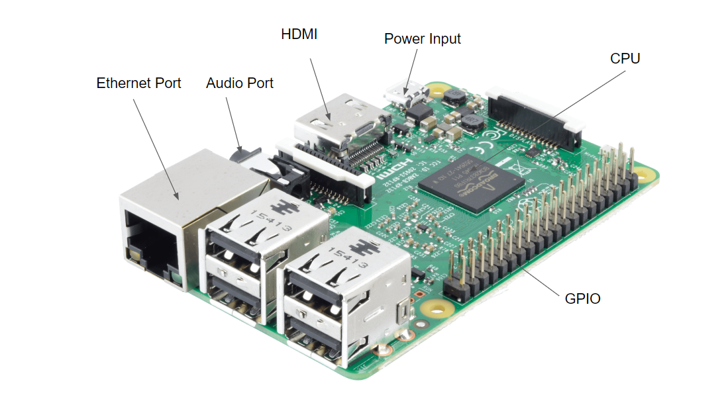

Slide 4
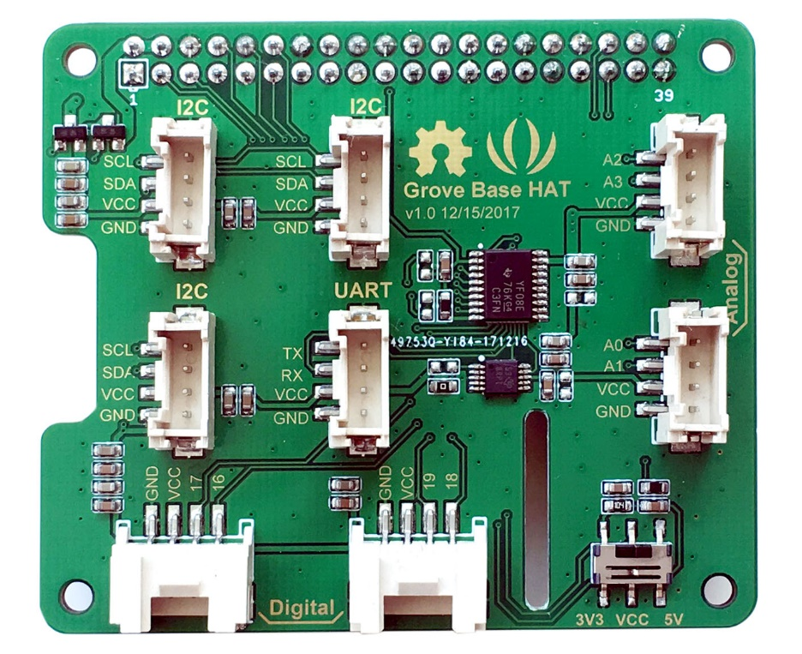
What is the function of the Grove Base HAT?
Grove Base HAT (shield) is an add-on board that has ports to add on sensors to the Raspberry Pi.

Slide 5
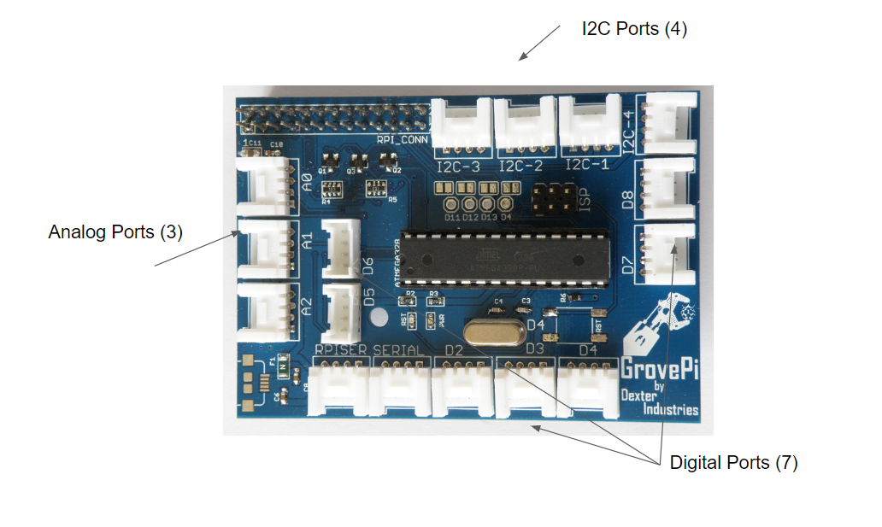

Slide 6
COMPONENTS TO ADD TO THE RASPBERRI PI
http://wiki.seeedstudio.com/Sensor/

Slide 7
